Slide 1
Predicting Solar Power Generation Using the NSRDB
Edward Seymour

Slide 2
The Problem
In recent years, the U.S. has seen large investments in green energy. Solar is the most popular for residential customers, for obvious reasons. However, residential customers are currently faced with a difficult question concerning solar; when is this going to pay itself off? Most people have no way of determining whether they’re location is right for solar based on their own knowledge. I plan to use a combination of weather and solar power generation data to create a model that can determine the time to pay off a solar installation.

Slide 3
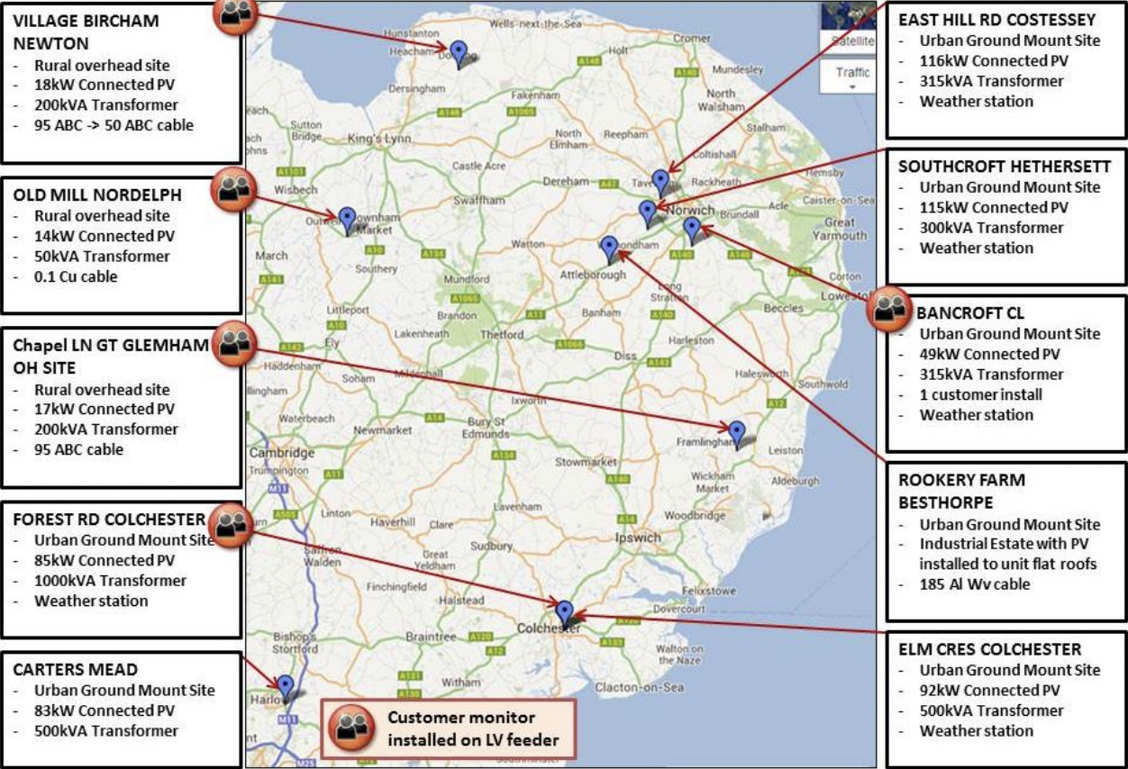

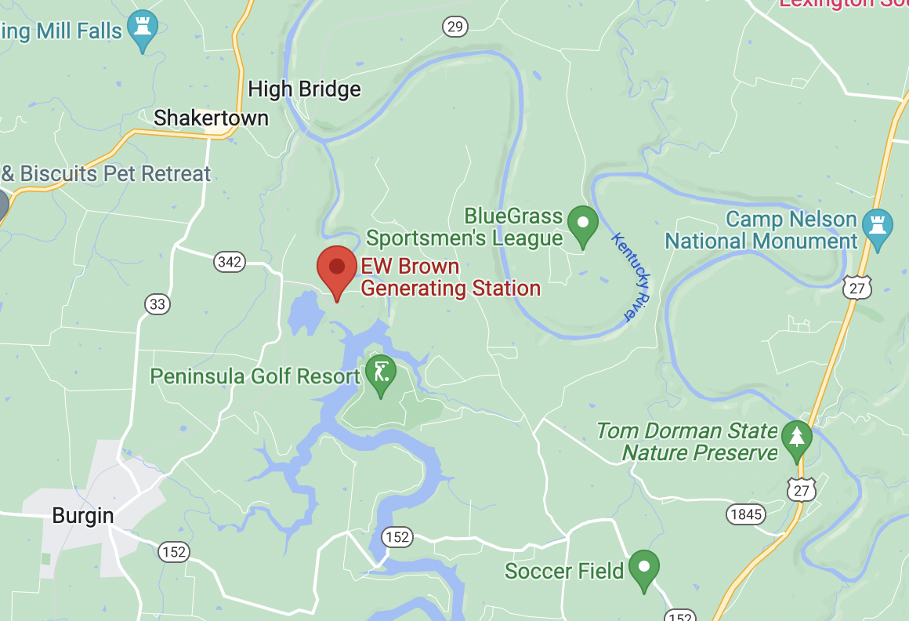
Data Sources:
U.K. Power Networks
National renewable Energy Laboratory - NSRDB
E.W. Brown Solar Facility

Slide 4
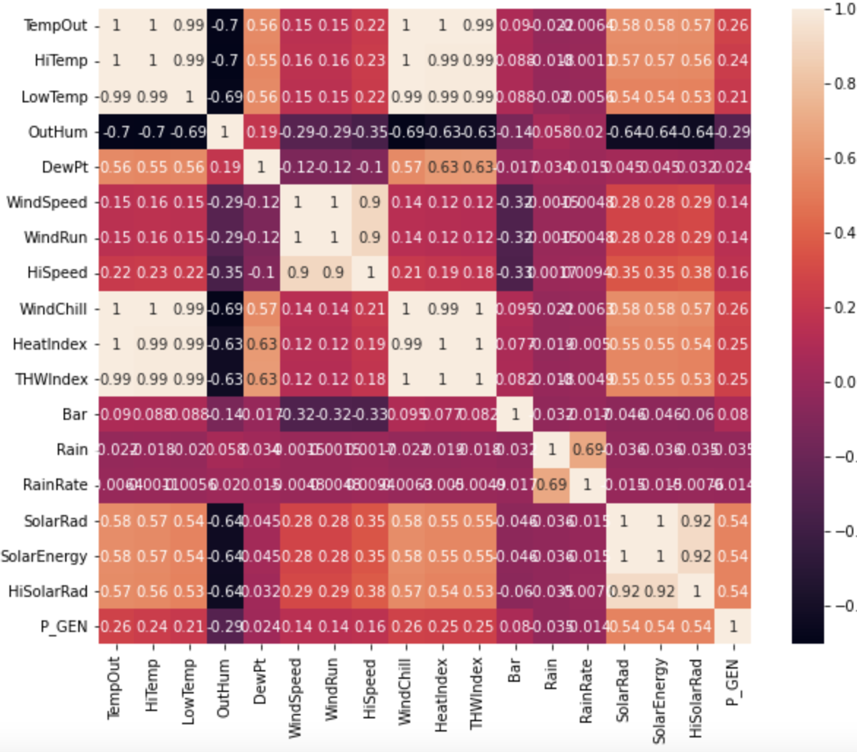
Correlations and Important Features
Temp and humidity are expectedly very correlated with wind chill and heat index
Solar radiation and temp are correlated with the amount of power generated.
Solar radiation is expected to be the most important feature to the model

Slide 5
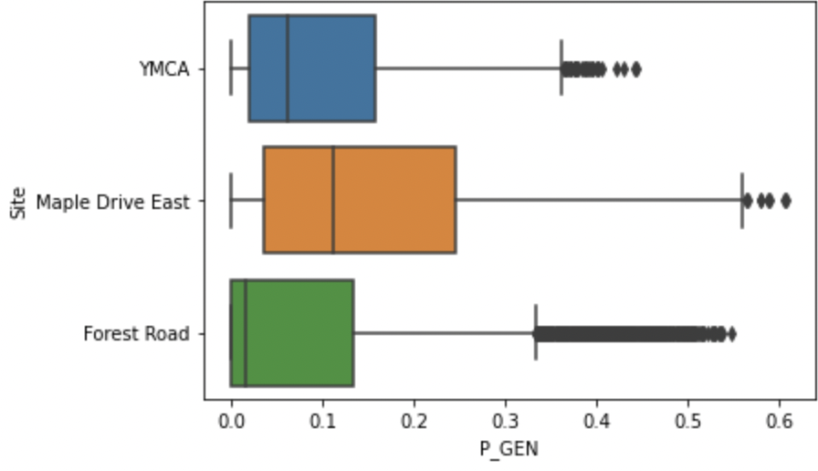
Power Generated at the Different U.K. Sites
None of the power stations generated much power at all. However, they all have outliers showing that sometimes the weather was right enough. These low numbers and large amount of outliers could be a problem for our model later on.

Slide 6
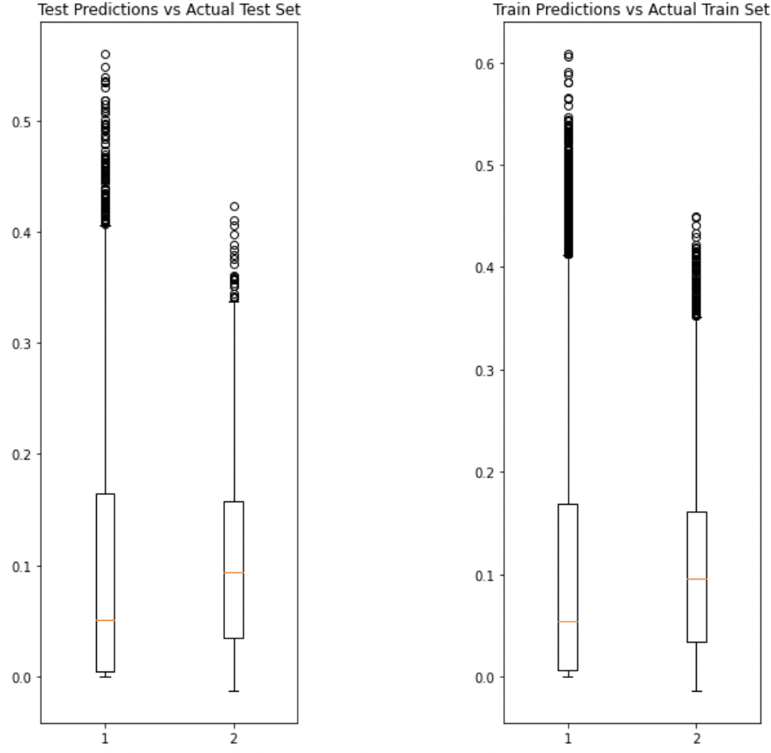
Initial Modeling Results
Initial modeling results show promise. We are achieving an r2 value of 0.66 on the training set and 0.44 on the test set. While not perfect, this does show that the features given are able to describe the target variable, at least somewhat
The best model was shown to be a gradient boosting regressor

Slide 7
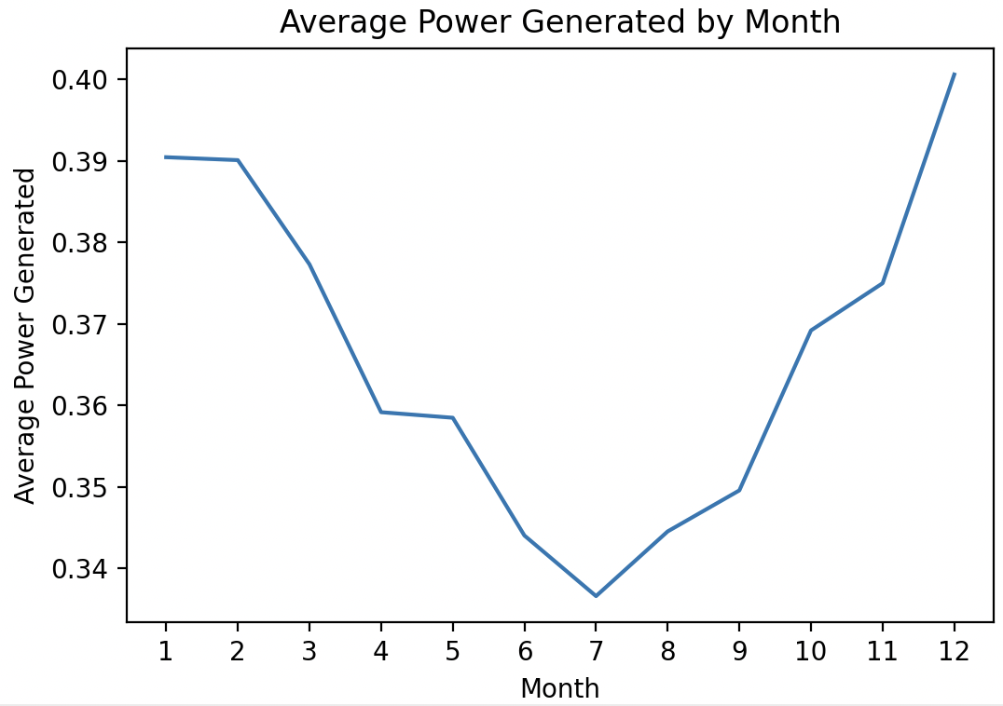
The Issue
The model worked well on the UK data in training. However, when used to predict on the NSRDB data, the model showed wildly incorrect data.
The model is showing the most power being generated in winter months and the least power being generated in summer months

Slide 8
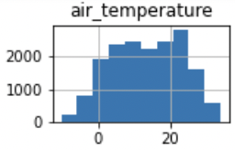
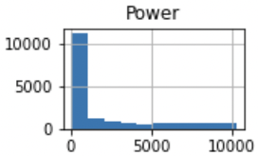
E. W. Brown Solar Facility
I re-trained the model with solar power data from the E.W. Brown Solar Facility and weather data from the NSRDB

Slide 9
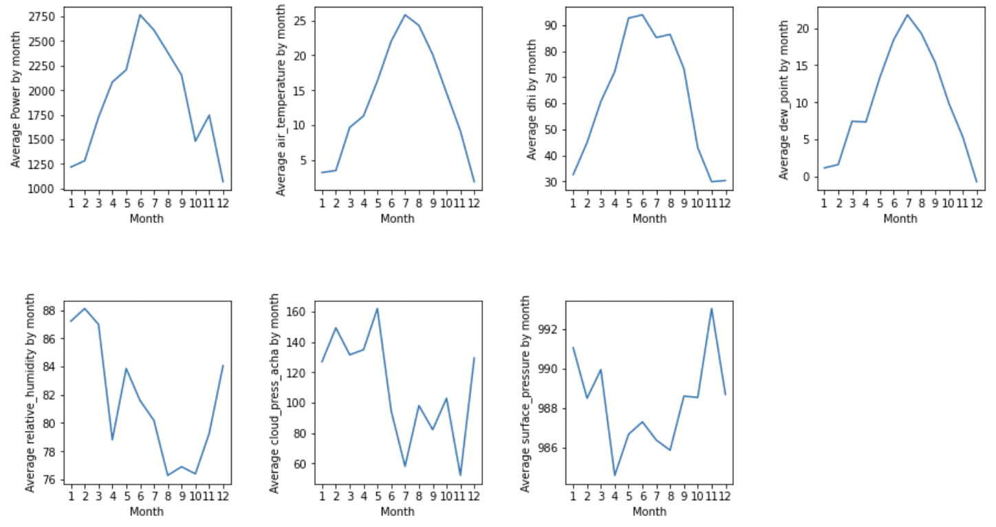
Final Modeling Results
After replacing the training data, the model that was found to perform the best was a random forest regressor.
The time estimated to pay off a 6kW installation is 12.5 years. This estimation does not include any money from tax credits, so it will be lower in actuality. However, this is a great result, as most sources place the time to pay of a solar investment at 5 to 15 years.

Slide 10
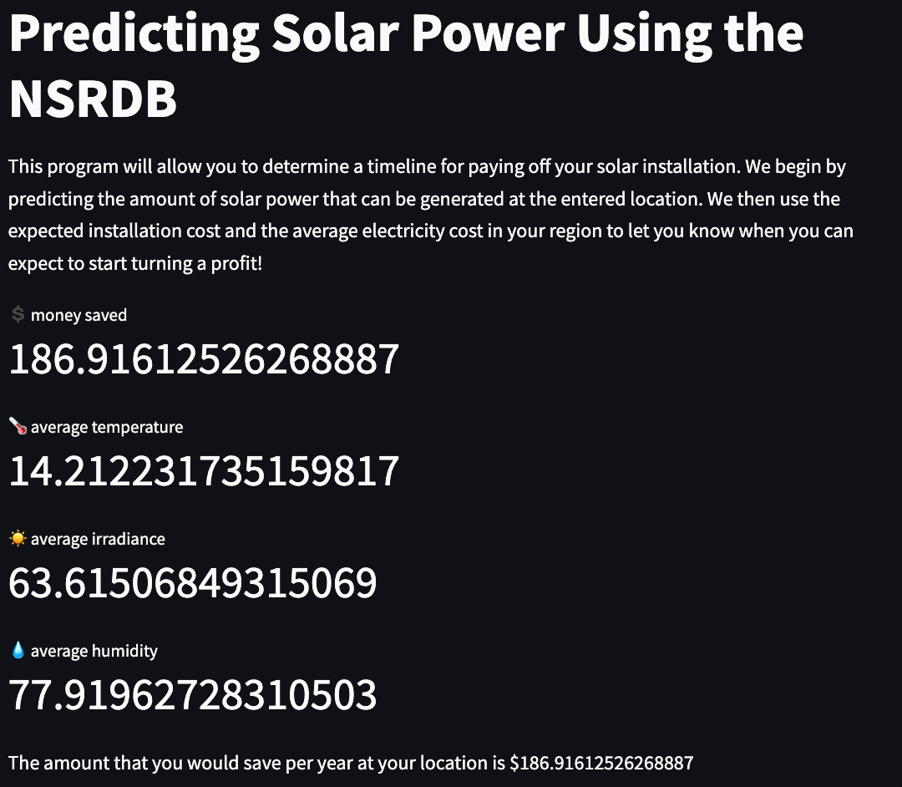
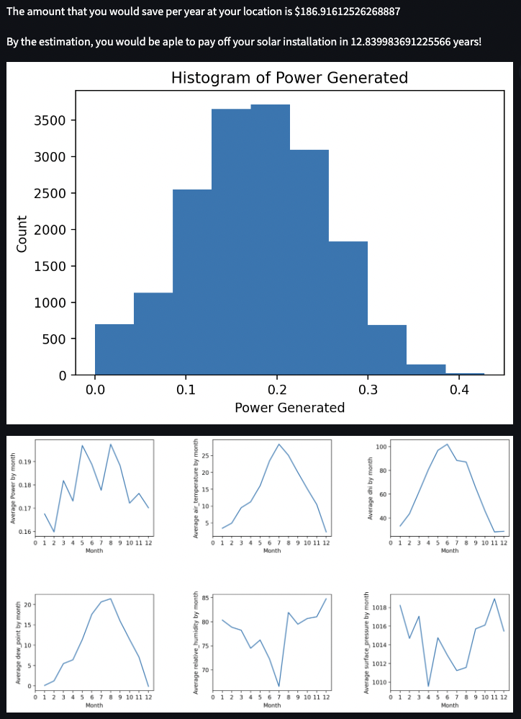
Streamlit App

Slide 11
Conclusion
The model now does a decent job at correctly predicting periods of high and low generation. It is also quite accurate on the time to pay off a solar investment, between 5 and 15 years for most locations. To improve the model, more U.S. solar locations could provide their generation data to be added to the training set. With more locations to train the model, more weather factors and their effect on solar power can be accounted for

Slide 12
Thank you

Slide 13
Citations
https://www.google.com/maps/place/E.W.+Brown+Generating+Station/@37.7822182,-84.7585519,12.07z/data=!4m5!3m4!1s0x8842892350c29433:0x63c4c1a8ac4f665b!8m2!3d37.7884044!4d-84.7136606?hl=en, Google Images, 3 January, 2023.
https://www.ofgem.gov.uk/sites/default/files/docs/2015/03/pv_tool_cdr_final_0.pdf, Validation of Photovoltaic (PV) Connection Assessment Tool, UK Power Networks, 3 January 2023
https://www.nrel.gov/, National Renewable Energy Laboratory, 3 January , 2023

